Slide 1
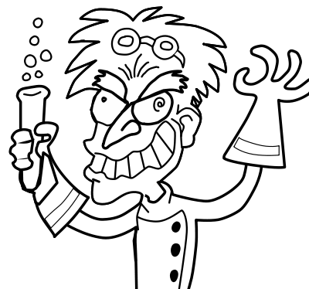
Atomic Structure

Slide 2
Atomic Structure
Atoms consist of electrons surrounding a nucleus that contains protons and neutrons.
Protons
Neutrons
Electrons
Lesson Activity
Click on each button to learn about that item.

Slide 3
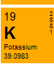
Protons
They are in the nucleus of an atom.
The number of protons in an atom is called its atomic number. In the periodic table atoms are arranged in atomic number order.
They are positively charged (+1).
They have a mass of 1 mass unit.
Back to start

Slide 4
Neutrons
They are in the nucleus of an atom.
They are neutrally charged. ( 0 )
They have a mass of 1 mass unit.
Back to start

Slide 5

Electrons
They surround the nucleus of the atom.
They are negatively charged. (-1)
The total number of electrons in an atom is always the same as the number of protons in the nucleus. This means atoms have no overall electrical charge.
They have a mass of =0 mass unit.
Back to start

Slide 6
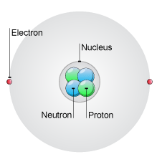
What have we learnt?
Particle | Relative charge | Weight
Proton | +1 | 1
Neutron | 0 | 1
Electron | -1 | 0
Back to start

Slide 7
Activity 1 What’s in it?
Lithium
Protons: 3
Neutrons: 4
Electrons: 3
Magnesium
Protons: 12
Neutrons: 12
Electrons: 12
Sulphur
Protons: 19
Neutrons: 20
Electrons: 19
Back to start

